Slide 1
Introduction to Machine Learning: A Hands-on Workshop
Zoë Wilkinson Saldaña, MSI
Arcus Education, DBHi

Slide 2

Hello!
Background: data science in academic libraries (Cornell University, University of Michigan)
Research interests: critical data science pedagogy; open source collaboration; reproducibility
Zoë Wilkinson Saldaña, MSI
Data Instructional Specialist
Arcus Education

Slide 3
Machine Learning with METACHOP
Introduction to Machine Learning *
Machine Learning II / Topics in ML

Slide 4
Machine Learning with METACHOP
Our schedule for today:
Presentation + Colab Setup: 12:10pm – 1pm
Hands-on Notebooks: 1pm– 2:30pm
Wrap-up discussion: 2:30pm-2:50pm
Self-guided work, learner questions: Here till 3:30pm

Slide 5
TAKEAWAYS
Critically apply machine learning methods to research questions
Develop + iterate a classification pipeline (using scikit-learn)
Find peers, colleagues, collaborators, co-learners

Slide 6

Turn to your neighbors
What project or problem are you currently working on that you hope to apply machine learning to?
What is the most important thing you hope to learn today?
Icons made by Freepik from www.flaticon.com

Slide 7
Why approach a research question with machine learning?

Slide 8
What is machine learning?

Slide 9
What is machine learning?
Generalizing from observed data to new, previously unobserved data (e.g. future observations, new datasets in problem domain)
Focused on prediction tasks such as assigning a label or value
Data-driven models that “learn” when exposed to training data

Slide 10
Relationship to Statistics
Statistics
model first
inference emphasis
Machine learning
data first
prediction emphasis

Slide 11
Types of machine learning

Slide 12
Types of Machine Learning
Supervised
Unsupervised
Reinforcement

Slide 13
Supervised learning
Map an input to an output
Can predict e.g. a label (benign/malignant) or continuous value (9 hours)
Relies on previously labeled pairs of input and output values, or labeled training data
(x_{i},yi)∝p(x,y) i.i.d.
x_{i}∈ℝ^{p}
y_{i}∈ℝ
f(x_{i})≈y_{i}

Slide 14
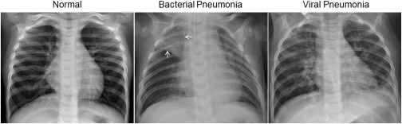
Examples of Supervised Learning
Spam detection
Diagnostic class based on medical imaging
Likelihood of a complication
Assigning class (normal/bacterial pneumonia/viral pneumonia) to chest X-rays

Slide 15
Generalization
Not only f(xi)≈yi
also for new data: f(x)≈y

Slide 16
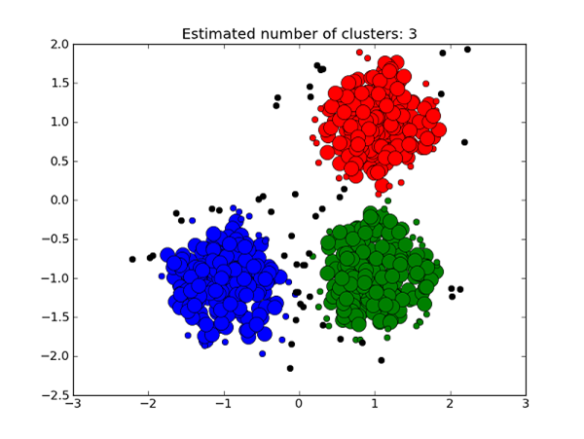
Unsupervised Learning
Assign labels to data
No labels in training data; system must identify independently, or based on a simple parameter (e.g. number of clusters)
x_{i}∝p(x) i.i.d.
Learn about p.
https://medium.com/deep-math-machine-learning-ai/different-types-of-machine-learning-and-their-types-34760b9128a2

Slide 17
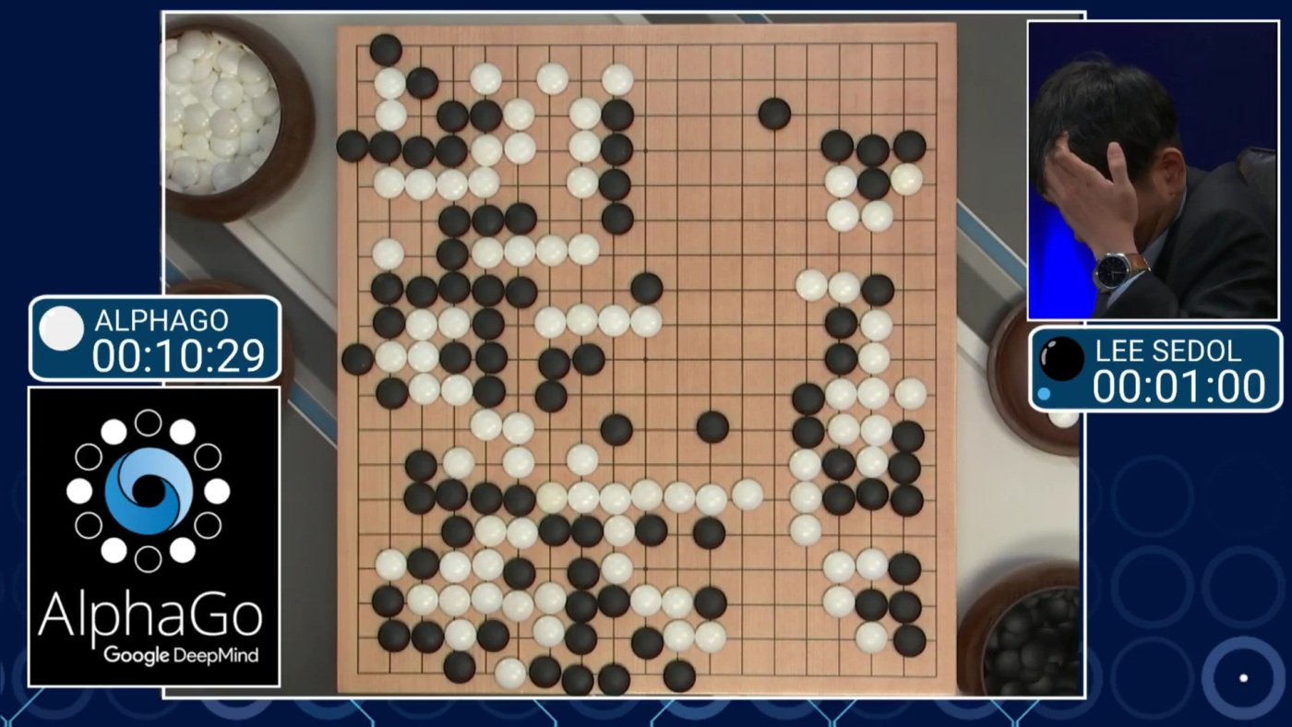
Reinforcement Learning

Slide 18
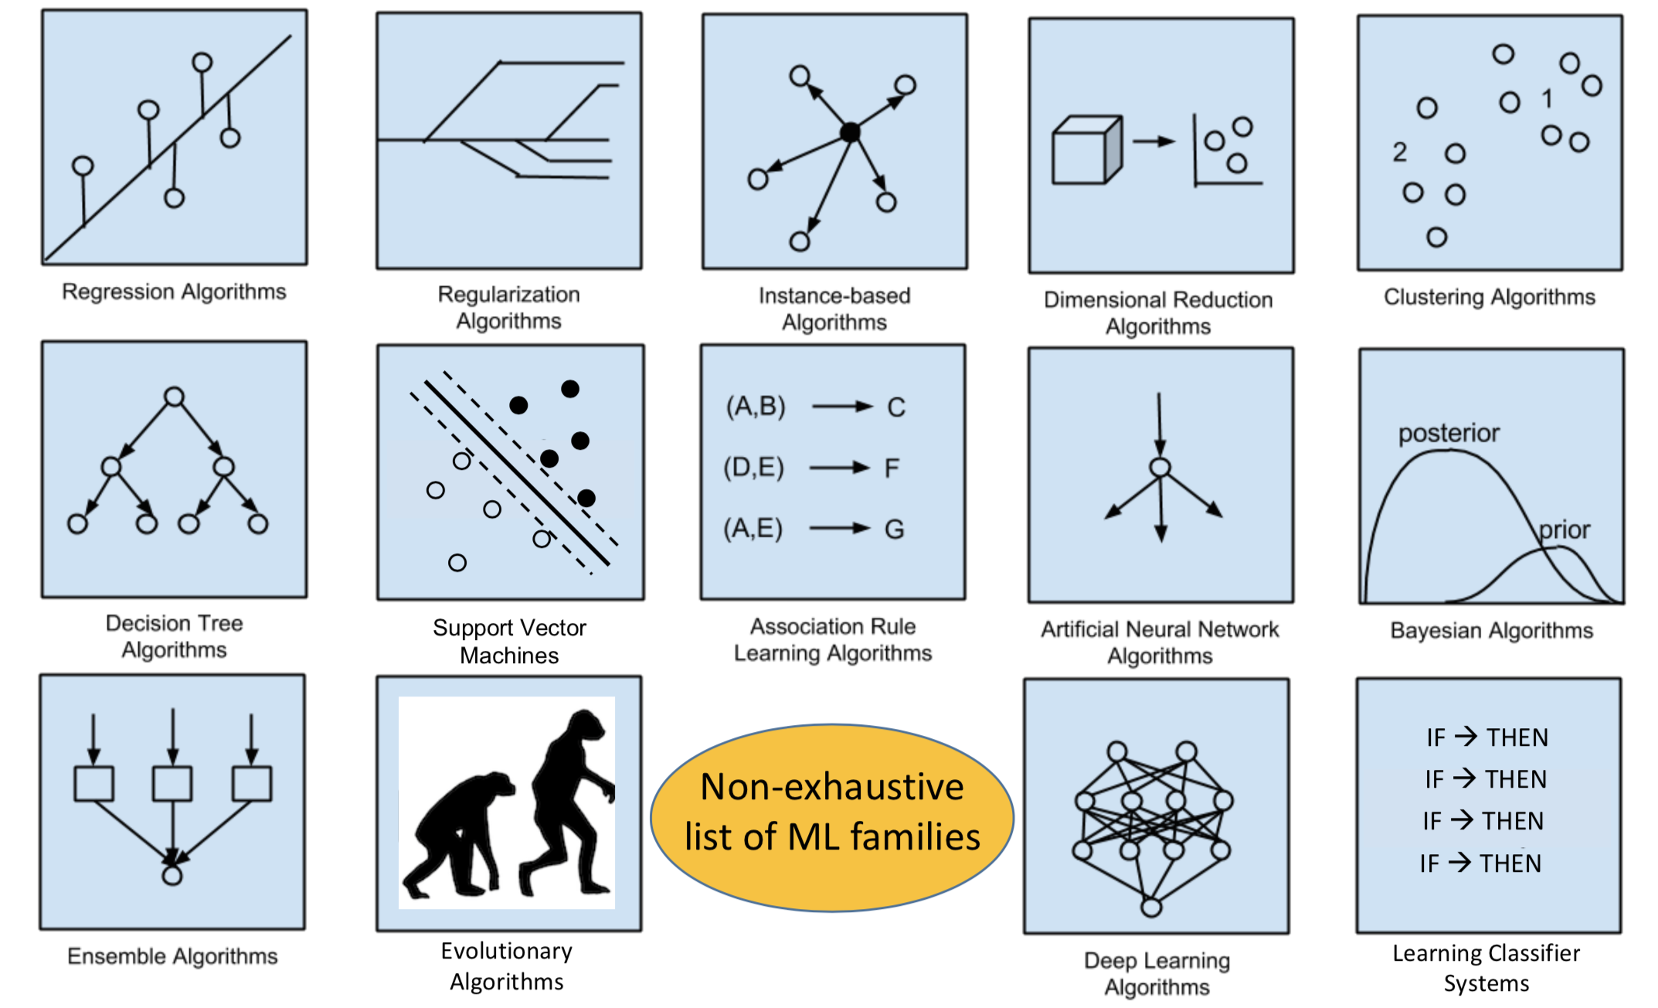
Model selection (& “no free lunch” theorem)

Slide 19
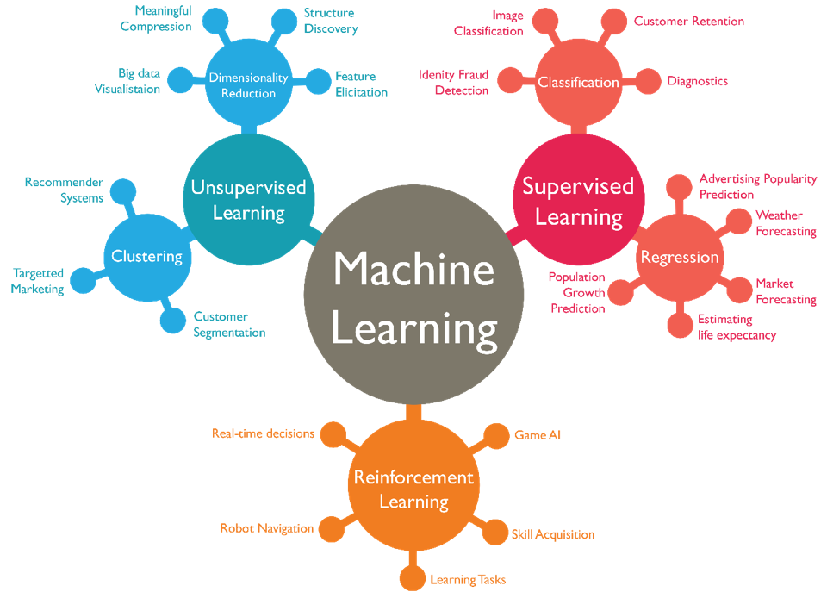

Slide 20
Turn to your neighbors
As a table, come up with an example of a research question that could be approached with:
Supervised learning
Unsupervised learning
Reinforcement learning
What data would you need?
Icons made by Freepik from www.flaticon.com

Slide 21
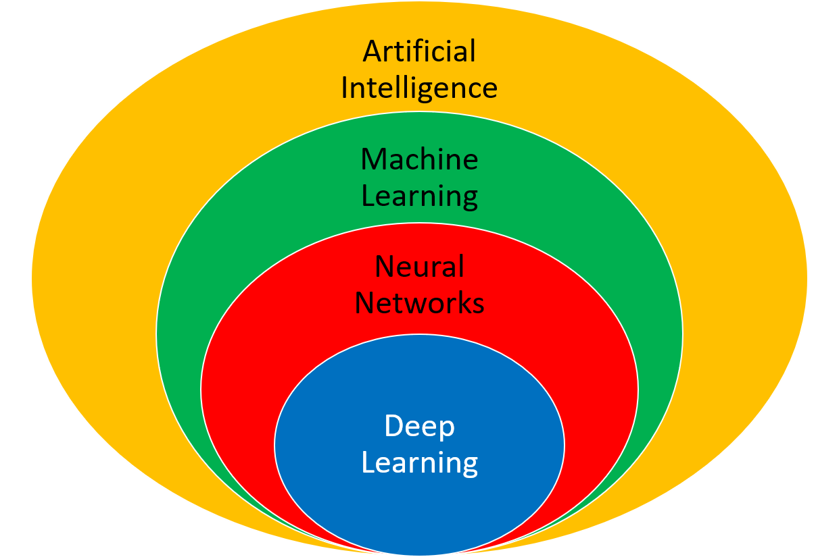
Other kinds of learning
Semi-supervised
Active Learning
Forecasting
…
https://apmonitor.com/do/index.php/Main/DeepLearning

Slide 22
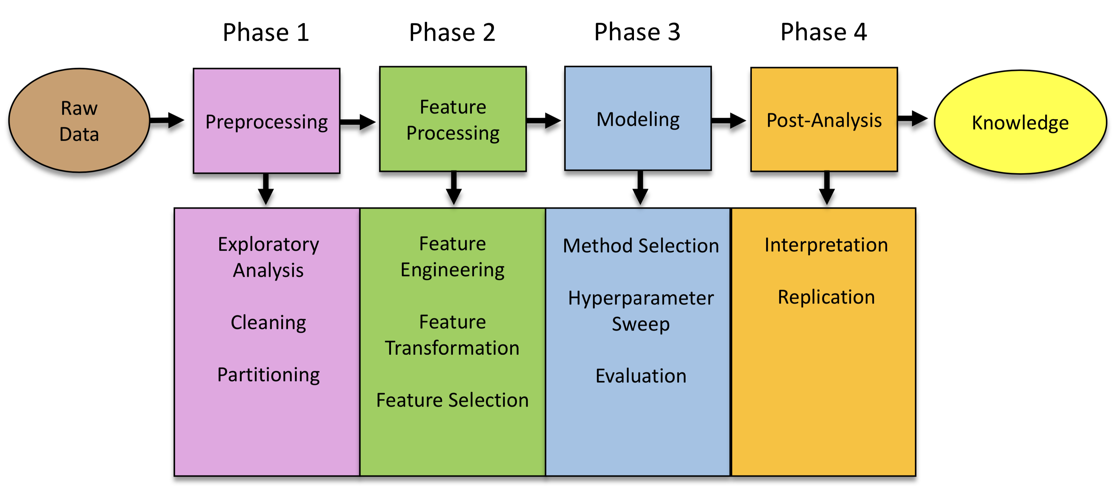
For today

Slide 23
The full spectrum

Slide 24

For today

Slide 26
Model selection (& “no free lunch” theorem)

Slide 27

Choosing the right estimator in scikit-learn
https://scikit-learn.org/stable/tutorial/machine_learning_map/index.html
https://scikit-learn.org/stable/tutorial/machine_learning_map/index.html

Slide 28
Classification and Regression
Classification
target y is discrete
Will you pass?
Regression
target y is continuous
How many points will you get in the exam?

Slide 29
Guiding principles in ML

Slide 30
Goal considerations

Slide 31
The Cost of Complex Systems
Data driven first? yes! (or maybe)
Machine Learning first: No!

Slide 32
Thinking in Context!
What is the baseline?
What is the benefit?

Slide 33
Communicating Results
Explainable results
[Example of classifications]

